Slide 1
Introduction and pitfalls of Java's new concurrency model
@David_Vlijmincx
www.davidvlijmincx.com | Oracle ACE

Slide 2
Outline
Current situation
Virtual threads
Structured concurrency

Slide 3
(Platform) Threads
var thread = new Thread(task); thread.start();

Slide 4
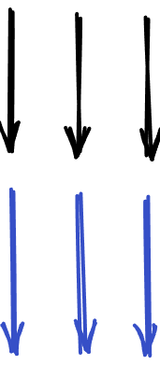
One thread for each task
Tasks
Threads

Slide 5
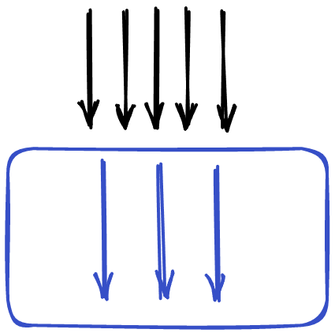
Executors
Tasks
Pooling threads for reuse
Leaking threads locals
Blocking methods

Slide 6
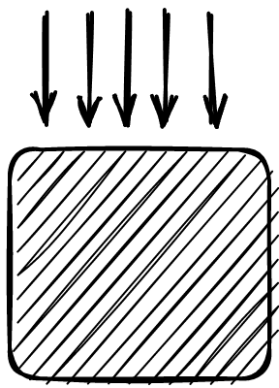
Async
Hard to write
Harder to read
Hard to debug
Tasks

Slide 7
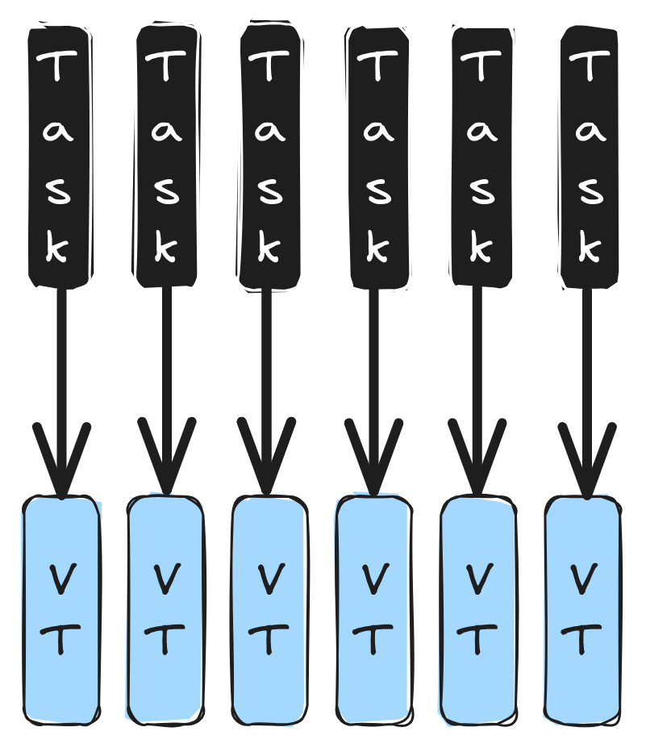
Virtual threads
Alternative implementation of Threads
The OS does not know about them
Concept inside the JVM
Stack frames live on the heap
Resizable stacks
You don’t have to allocate a lot of memory at the start
Cheap to create

Slide 9
Thread vt = Thread.startVirtualThread(printTask); try(ExecutorService vte = Executors.newVirtualThreadPerTaskExecutor()){ vte.submit(printTask); }

Slide 10
try(ExecutorService vte = Executors.newVirtualThreadPerTaskExecutor()){ for (int i = 0; i < 1_000_000; i++) { vte.submit(sleepOneSecond); } }

Slide 11
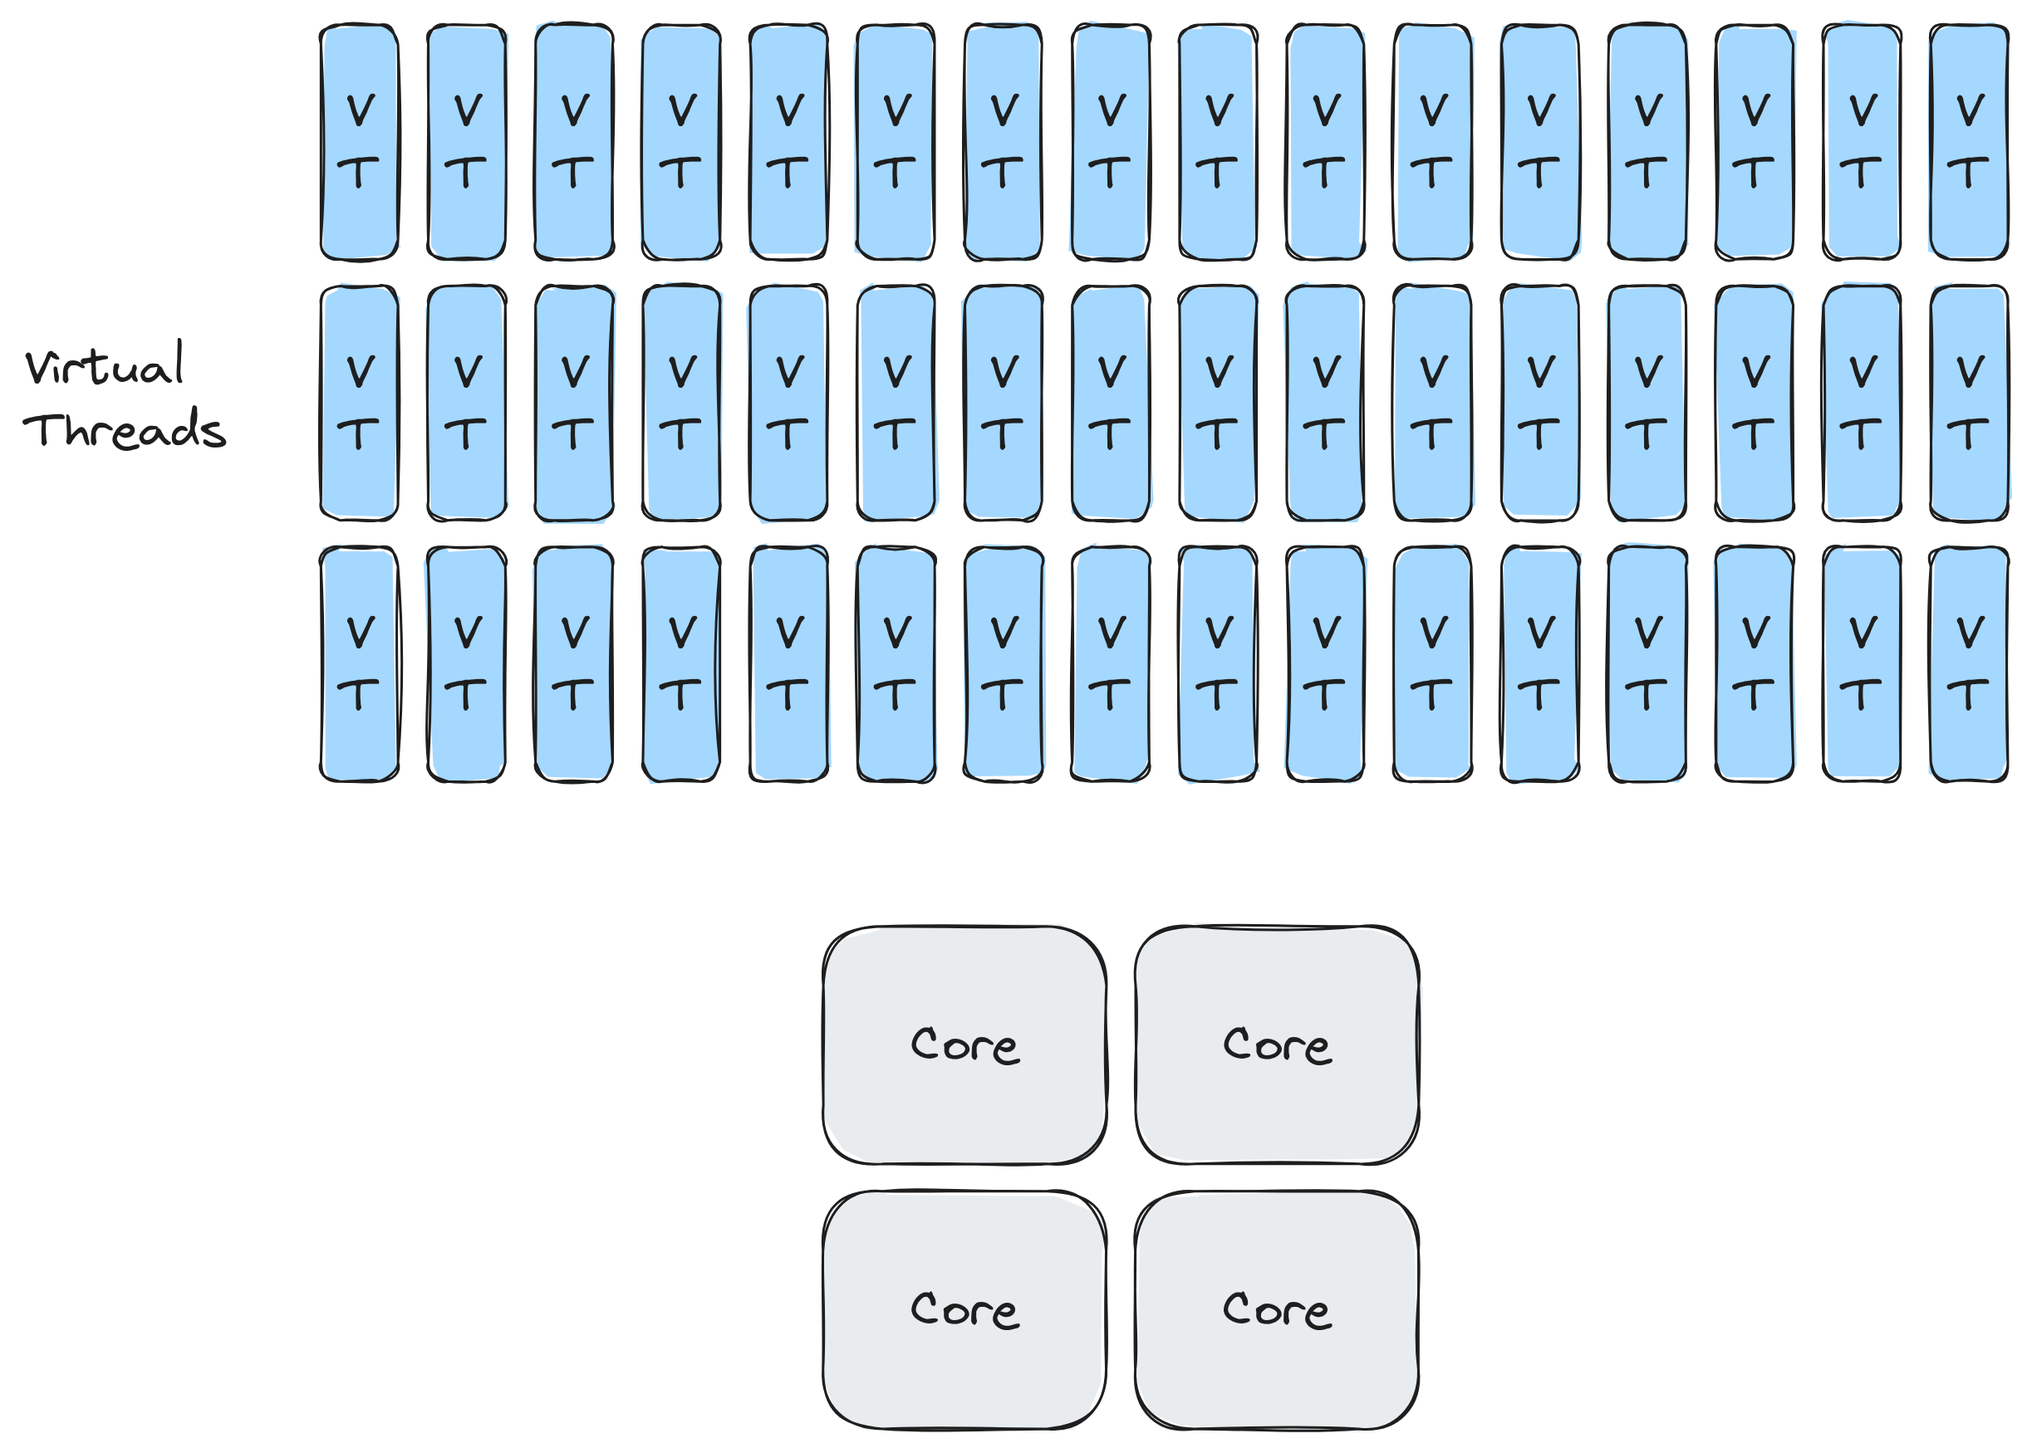
How does it work

Slide 12
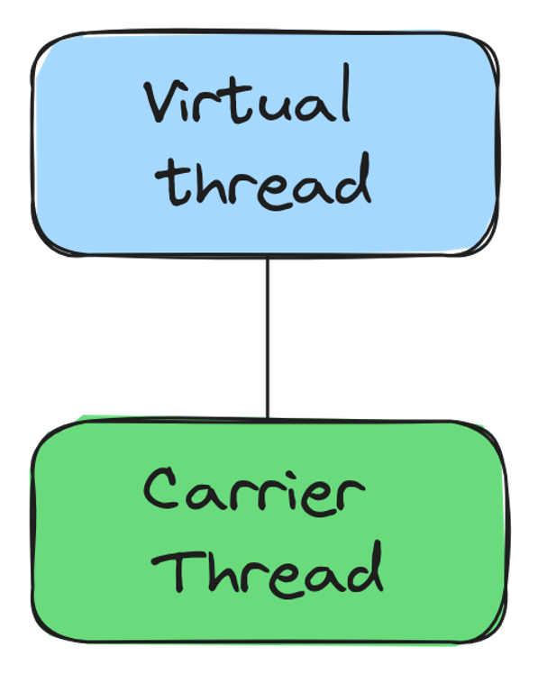
How does it work

Slide 13
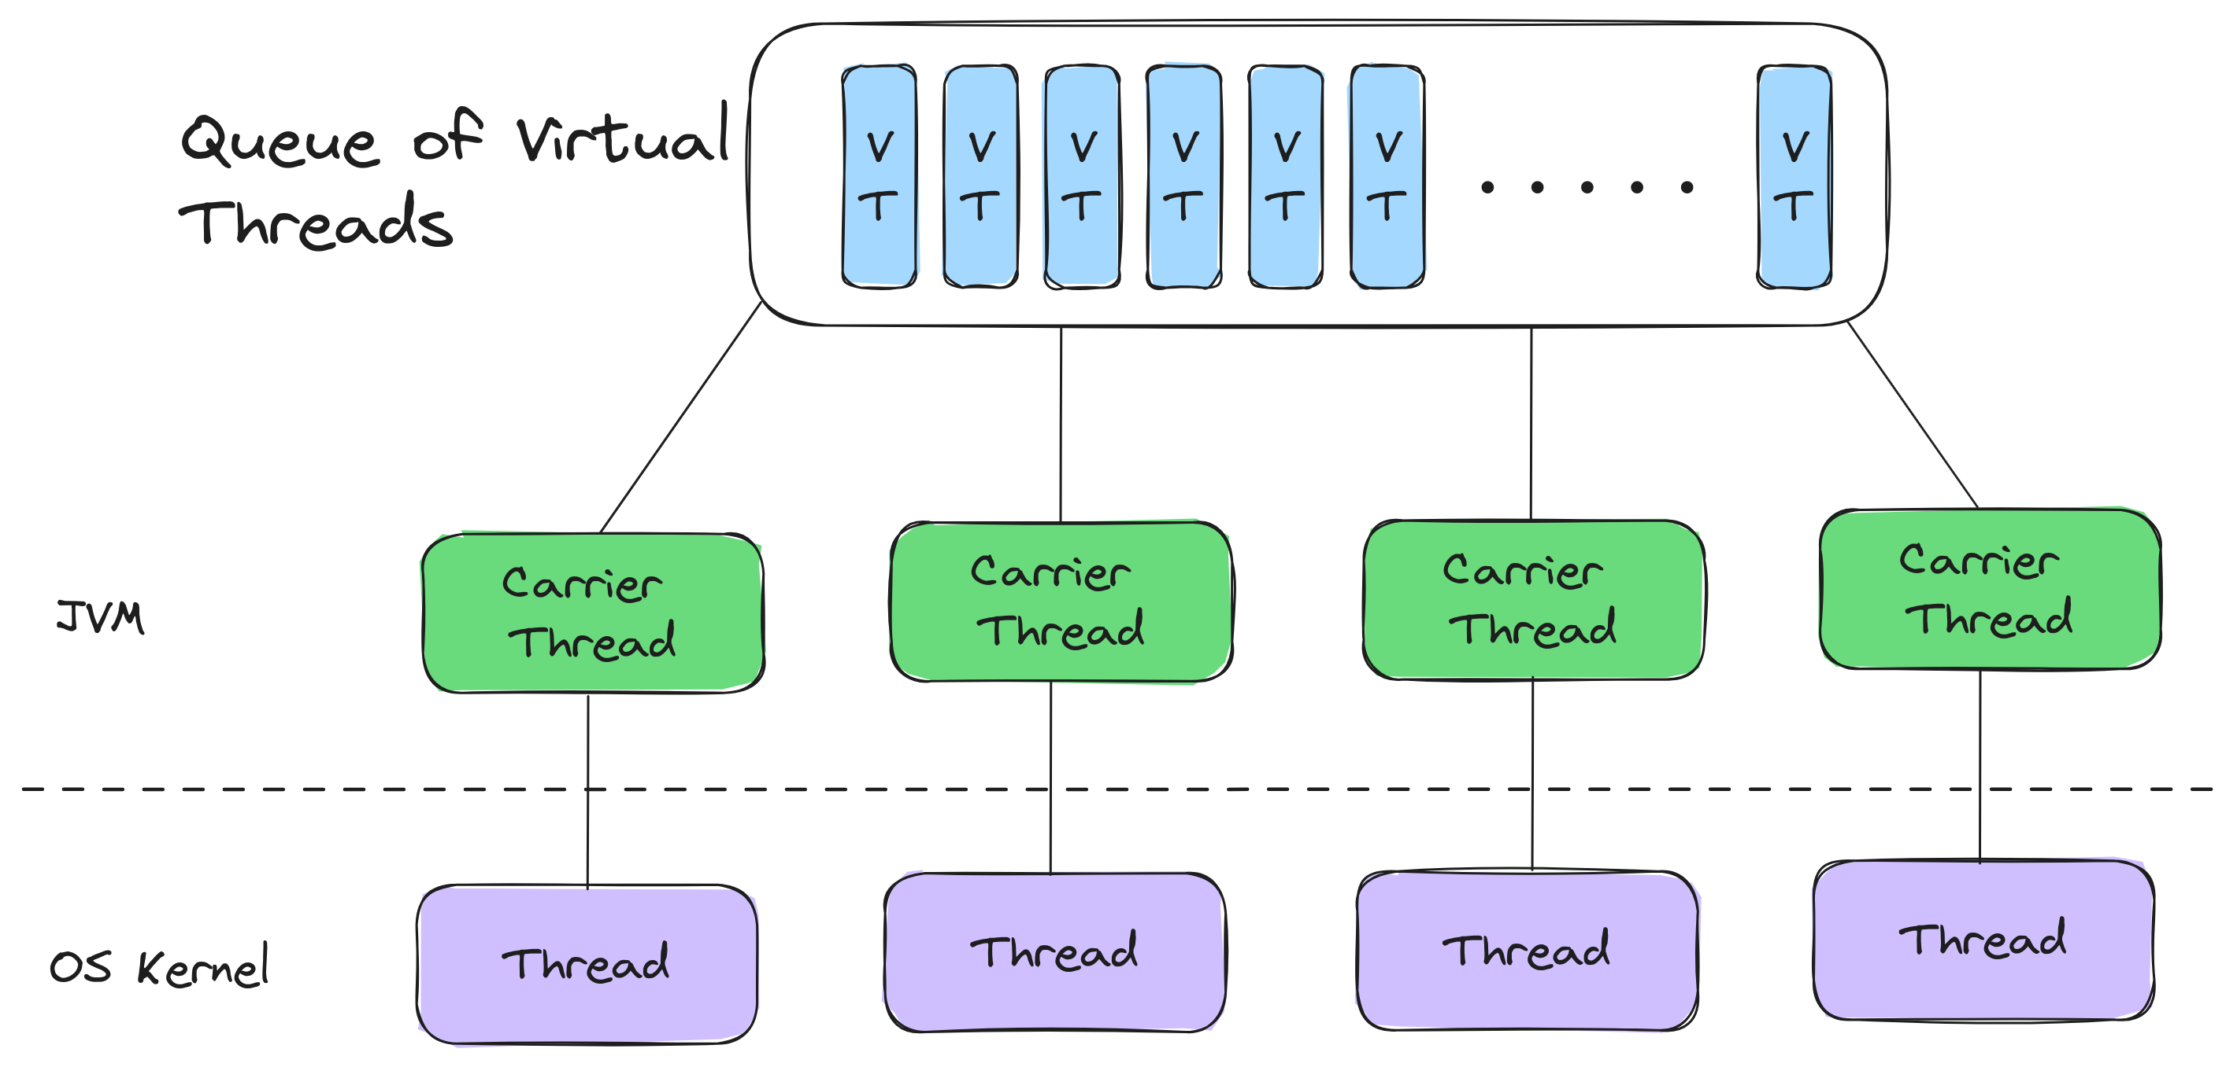
How does it work

Slide 14
Manage Carrier Threads
jdk.virtualThreadScheduler.parallelism=5
Change the default amount of carrier threads
jdk.virtualThreadScheduler.maxPoolSize=10
Hard limit on extra carrier threads

Slide 15
Mounting and unmounting

Slide 16
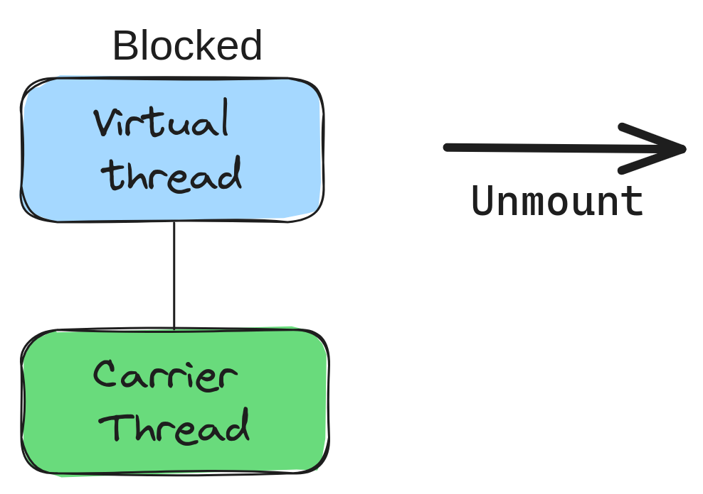
Mounting and unmounting

Slide 17
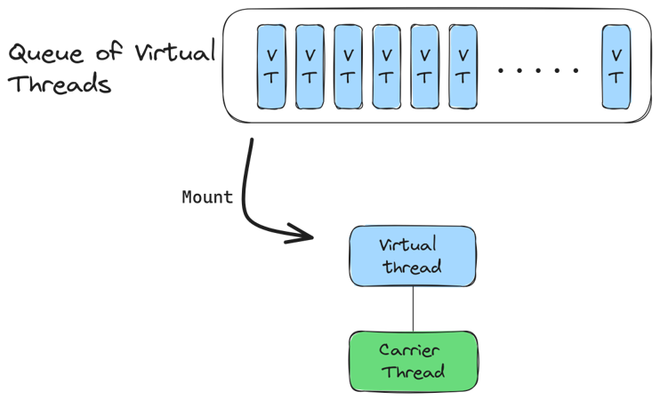
Mounting and unmounting

Slide 18
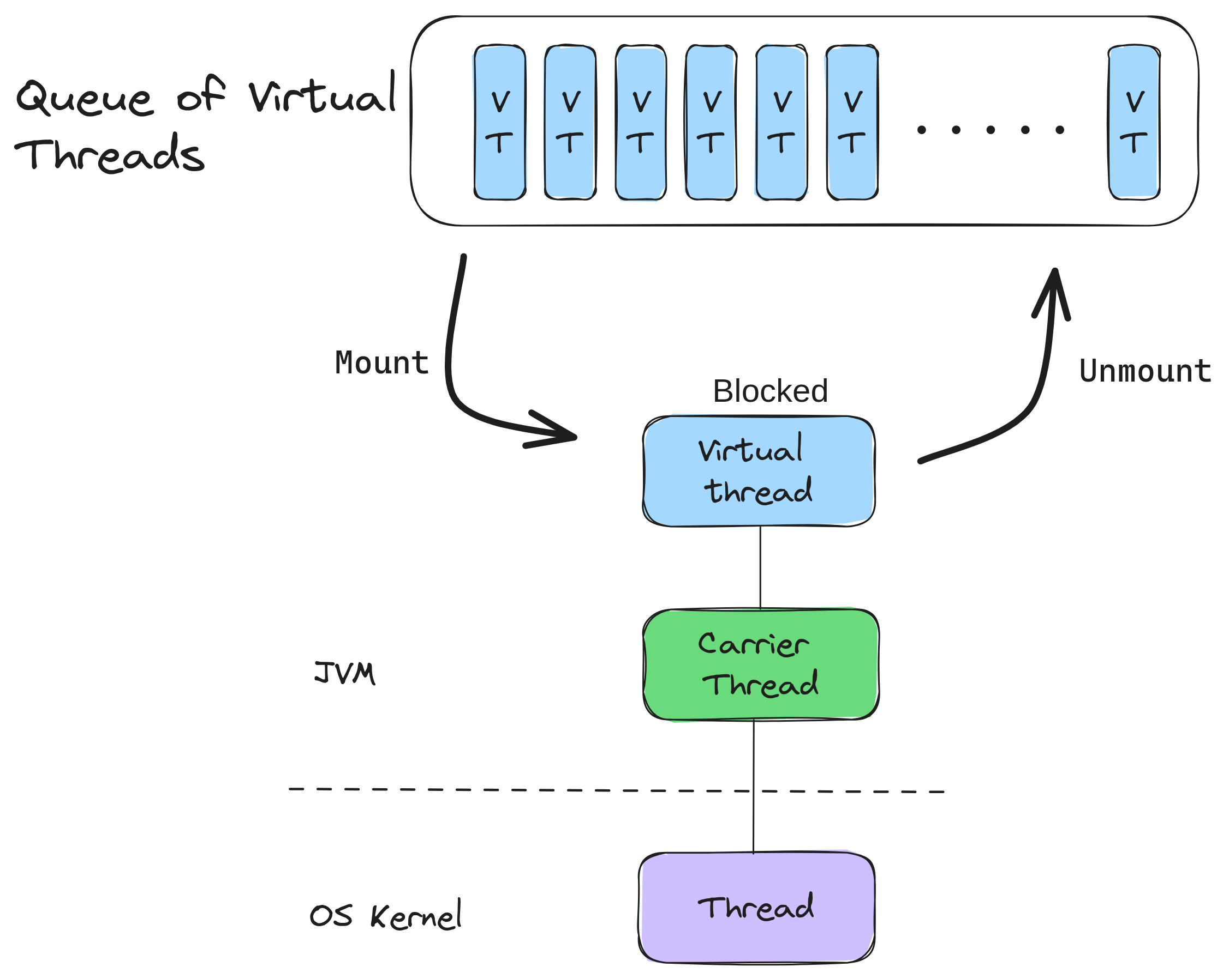
Mounting and unmounting

Slide 19
Not every method is ready
Synchronized Block
object.wait()
Calls to native code (JNI)

Slide 20
See pinned virtual threads
Run option:
-Djdk.tracePinnedThreads=short
System property:
jdk.tracePinnedThreads=full

Slide 21
Pitfalls
Don’t use them for long running calculations
Old libraries may not have adapted to virtual threads
Could use unsupported blocking methods

Slide 22
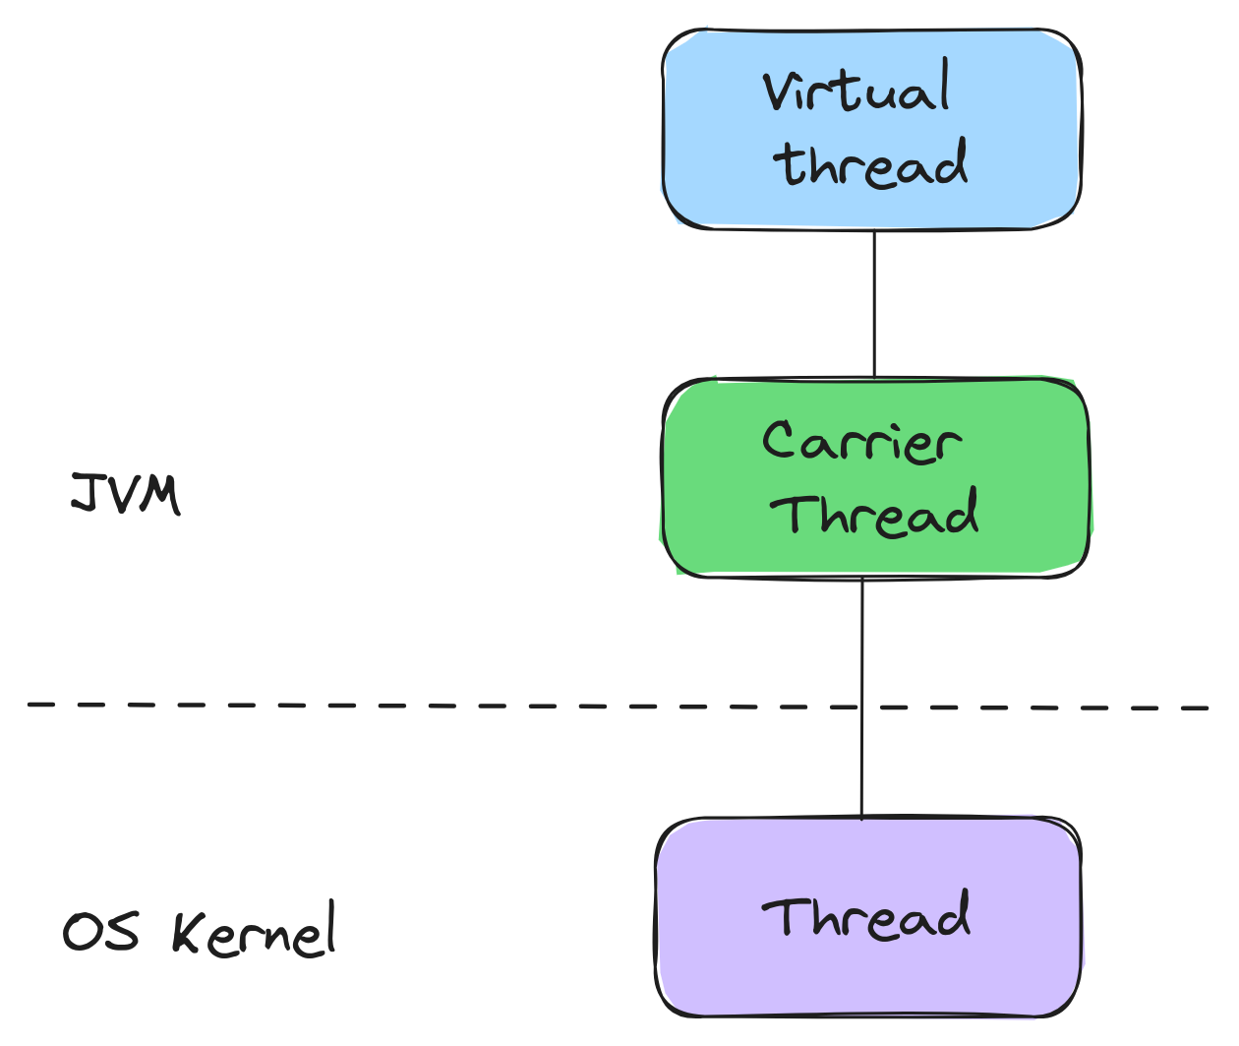
Virtual Threads are not faster than Platform Threads

Slide 23
Virtual thread Platform threads
Virtual thread Platform threads

Slide 24
Don't pool Virtual Threads
They are cheap to create
Pooling Virtual Threads is an anti-pattern
You should create a Virtual Thread for each task
Don't use a pool to limit access to a resource use locks instead

Slide 26
Structured concurrency

Slide 27
Structured Code
public String methodA(){ String foo = methodB(); String bar = methodC();
return foo + bar; }

Slide 28
Structured Code
public String methodA(){ String foo = methodB(); String bar = methodC();
return foo + bar; }
B
C
Result
A

Slide 29
Structured Code
public String methodA(){ String foo = methodB(); String bar = methodC();
return foo + bar; }
B
C
Result
A

Slide 30
Structured Code
public String methodA(){ String foo = methodB(); String bar = methodC();
return foo + bar; }
B
C
Result
A

Slide 31
Implicit relation
static public String methodA() throws … { Future<String> foo = methodB(); Future<String> bar = methodC(); return foo.get() + bar.get(); }
C
B
Result
A

Slide 32
Implicit relation
static public String methodA() throws … { Future<String> foo = methodB(); Future<String> bar = methodC(); return foo.get() + bar.get(); }
C
B
Result
A

Slide 33
Implicit relation
static public String methodA() throws … { Future<String> foo = methodB(); Future<String> bar = methodC(); return foo.get() + bar.get(); }
C
B
Result
A

Slide 34
Implicit relation
static public String methodA() throws … { Future<String> foo = methodB(); Future<String> bar = methodC(); return foo.get() + bar.get(); }
C
B
Result
A

Slide 35
try (StructuredTaskScope.ShutdownOnSuccess<String> scope =
new StructuredTaskScope.ShutdownOnSuccess<>()) { scope.fork(() -> "result-1"); scope.fork(() -> "result-2"); scope.join(); System.out.println(scope.result()); }

Slide 36
Pitfalls
Managing the lifetime of threads yourself
Joining
Exceptions
Time outs
Etc.

Slide 37
All you need to get started
Thread t = Thread.startVirtualThread(task); var executor = Executors.newVirtualThreadPerTaskExecutor();

Slide 38
Thank you!
@David_Vlijmincx
www.davidvlijmincx.com

